Slide 1
Hamilton Decompositions
joint work with:-
Brian Alspach
Matt Dean
Sara Herke
Don Kreher
Barbara Maenhaut
Ben Smith
Bridget Webb
Hamilton decompositions of line graphs.
Hamilton decompositions of Cayley graphs.

Slide 2
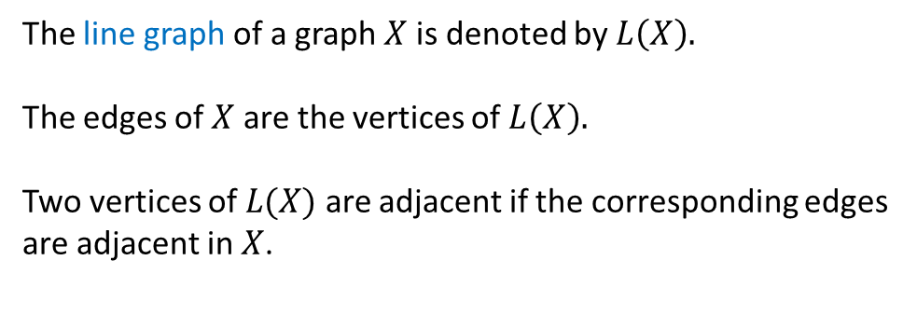
Let $X$ be a $k$-regular graph. A Hamilton decomposition of $X$ is a set of $⌊$ $\frac{k}{2} ⌋$ edge-disjoint Hamilton cycles.
The line graph of a graph $X$ is denoted by $L\left(X\right).$
The edges of $X$ are the vertices of $L\left(X\right).$
Two vertices of $L(X)$ are adjacent if the corresponding edges are adjacent in $X$.
$$u$$
$$k−1$$
$$uv$$
$$L(X)$$
$$v$$
$$X$$
$k$-regular
$2(k−1)$-regular

Slide 3
Hamilton decompositions of line graphs
Let $X$ be a 3-regular graph $X$. Then $X$ is Hamiltonian ↔ $L(X)$ has a Hamilton decomposition. (Kotzig, 1963)
Let $X$ be a $k$-regular graph $X$. Then $X$ is Hamiltonian ↔ $L(X)$ has a Hamilton decomposition. ???
$←$ For each $k≥4$, there exists a $k$-regular graph $X$ such that $L(X)$ has a Hamilton decomposition, but $X$ is not Hamiltonian.
…
$$L\left(X\right)→H$$
$$L\left(X\right)→H$$

Slide 4
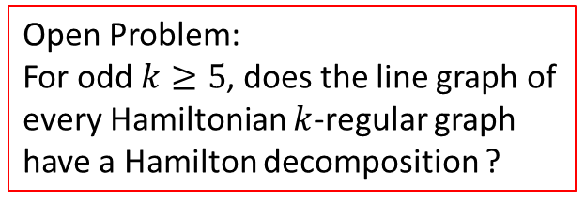
Hamilton decompositions of line graphs
Let $X$ be a 3-regular graph $X$. Then $X$ is Hamiltonian ↔ $L(X)$ has a Hamilton decomposition. (Kotzig, 1963)
Let $X$ be a $k$-regular graph $X$. Then $X$ is Hamiltonian ↔ $L(X)$ has a Hamilton decomposition. ???
$→$ Let $X$ be a $k$-regular graph $X$ with $k$ even.
Then $X$ is Hamiltonian $→$ $L(X)$ has a Hamilton decomposition.
(Bryant, Maenhaut, Smith; 20??)
Conjecture (Bermond, 1988):
If $X$ has a Hamilton decomposition, then so does $L\left(X\right).$
$→$ Let $X$ be a $k$-regular graph $X$ with $k$ odd.
Then $X$ has a Hamiltonian $3$-factor $→$ $L(X)$ has a Hamilton decomposition.
(Bryant, Maenhaut, Smith; 20??)
Open Problem:
For odd $k≥5$, does the line graph of every Hamiltonian $k$-regular graph have a Hamilton decomposition ?

Slide 5
Hamilton decompositions of line graphs
For a $k$-regular graph $X$ with $k$ even, is it true that $L(X)$ has a Hamilton decomposition if and only if $L(X)$ is $2(k−1)$-edge connected?
(Jackson, 1991)
For all $k≥3$ there exists a $k$-regular graph $X$ such that $L(X)$ is $2(k−1)$-edge connected but $L(X)$ does not have a Hamilton decomposition.
3 Hamilton cycles: RED BLUE GREEN

Slide 6
Hamilton decompositions of Cayley graphs
Conjecture: Connected Cayley graphs on finite abelian groups have Hamilton decompositions.
(Alspach 1984)
The conjecture holds for degree $≤5$.
Bermond, Favaron, Maheo, 1989
and in lots of cases when degree $=6$.
Dean, Kreher, Liu, Westlund 2007-2009
The conjecture holds if the connection set is a minimal Cayley generating set.
Liu 1994-2003
The conjecture holds if the graph has order $p^{2}$ where $p$ is prime.
Alspach, Bryant, Kreher 2013
There exist connected Cayley graphs on infinite abelian groups that have NO Hamilton decomposition.
There exist connected Cayley graphs on finite non-abelian groups that have NO Hamilton decomposition.

Slide 7
Hamilton decompositions of Cayley graphs
The natural infinite analogue of a Hamilton cycle is a spanning double ray … spanning connected 2-regular graph
Consider the infinite Cayley graph $Cay(ℤ ,±\left\{1,2,3\right\})$.
…
…
edge cut of size $6$ $(=1+2+3)$
But any Hamilton cycle crosses the edge cut an odd number of times. Since we need 3 Hamilton cycles, there is no Hamilton decomposition.
$$∑S^{+}≡\left|S^{+}\right|(mod 2)$$
OPEN PROBLEM: Does every connected $Cay(ℤ , S)$ satisfying $∑S^{+}≡\left|S^{+}\right| (mod 2)$ have a Hamilton decomposition ?
Yes when $Cay(ℤ , S)$ is 4-regular graph, when $S=±\{1,2,…,n\}$, and in lots of other cases.
(Bryant, Herke, Maenhaut, Webb 2018)
Conjecture: Connected Cayley graphs on finite abelian groups have Hamilton decompositions.
(Alspach 1984)

Slide 8
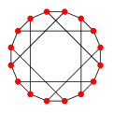
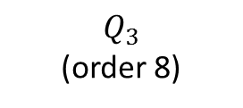
Hamilton decompositions of Cayley graphs
Let $X$ be a connected 3-regular graph that is bipartite, has order divisible by 4, and has a regular group action on its arcs.
$$Q_{3}$$
It is known that there are infinitely many such graphs (Conder, Nedela 2009).
The first three such graphs are:-
$$2Q_{3}$$
$$Q_{3}$$
(order 8)
Möbius-Kantor graph
(order 16)
Desargues graph
(order 20)
Form the graph $K\left(2X\right)$ from $X$ by replacing each edge with a pair of parallel edges, and then replacing each vertex with a copy of $K_{6}$.
$$K(2Q_{3})$$
Claim: $K\left(2X\right)$ is a Cayley graph and has no Hamilton decomposition.
The regular action on the arcs of $X$ guarantees that $K\left(2X\right)$ is a Cayley graph.

Slide 9
Hamilton decompositions of Cayley graphs
For a contradiction, suppose $K\left(2X\right)$ has a Hamilton decomposition.
$K(2X)$ is 6-regular so there are 3 Hamilton cycles in a Hamilton decomposition. Colour them red, blue and green.
There are exactly two edges of each colour entering/leaving each $K_{6}$.
$$K(2Q_{3})$$
Collapsing each $K_{6}$ induces a Hamilton decomposition of $2X$.
$$F_{2}$$
OPEN QUESTION:
Are there any smaller Cayley graphs that have no Hamilton decomposition?
$$F_{1}$$
A Hamilton decomposition of $2X$ induces a perfect 1-factorisation of $X$.
But bipartite graphs of order divisible by 4 have no perfect 1-factorisation (Kotzig, 1963).
$$F_{3}$$
Theorem. There exist infinitely many connected 6-regular Cayley graphs that have no Hamilton decomposition.
Bryant, Dean 2015.

Slide 10
Hamilton decompositions of Cayley graphs
There exist at least two connected 4-regular Cayley graphs having no Hamilton decomposition.
(1) $K\left(L\left(P\right)\right)$ where $P$ is the Petersen graph is a connected 4-regular Cayley graph on $A_{5}$
and has no Hamilton decomposition.
Open Problem: Are there any more connected 4-regular Cayley graphs that have no Hamilton decomposition?
(2) $K\left(L\left(C\right)\right)$ where $C$ is the Coxeter graph is a connected 4-regular Cayley graph on $PSL(2,7)$
and has no Hamilton decomposition.
Every other connected 4-regular Cayley graph of order $≤168$ has a Hamilton decomposition.
McKay and Royle 2014
THE END
4-regular Cayley graph on $A_{5}$ that has no Hamilton decomposition.

